Slide 1

Profibus
Presenter: Abolfazl Daniali

Slide 2
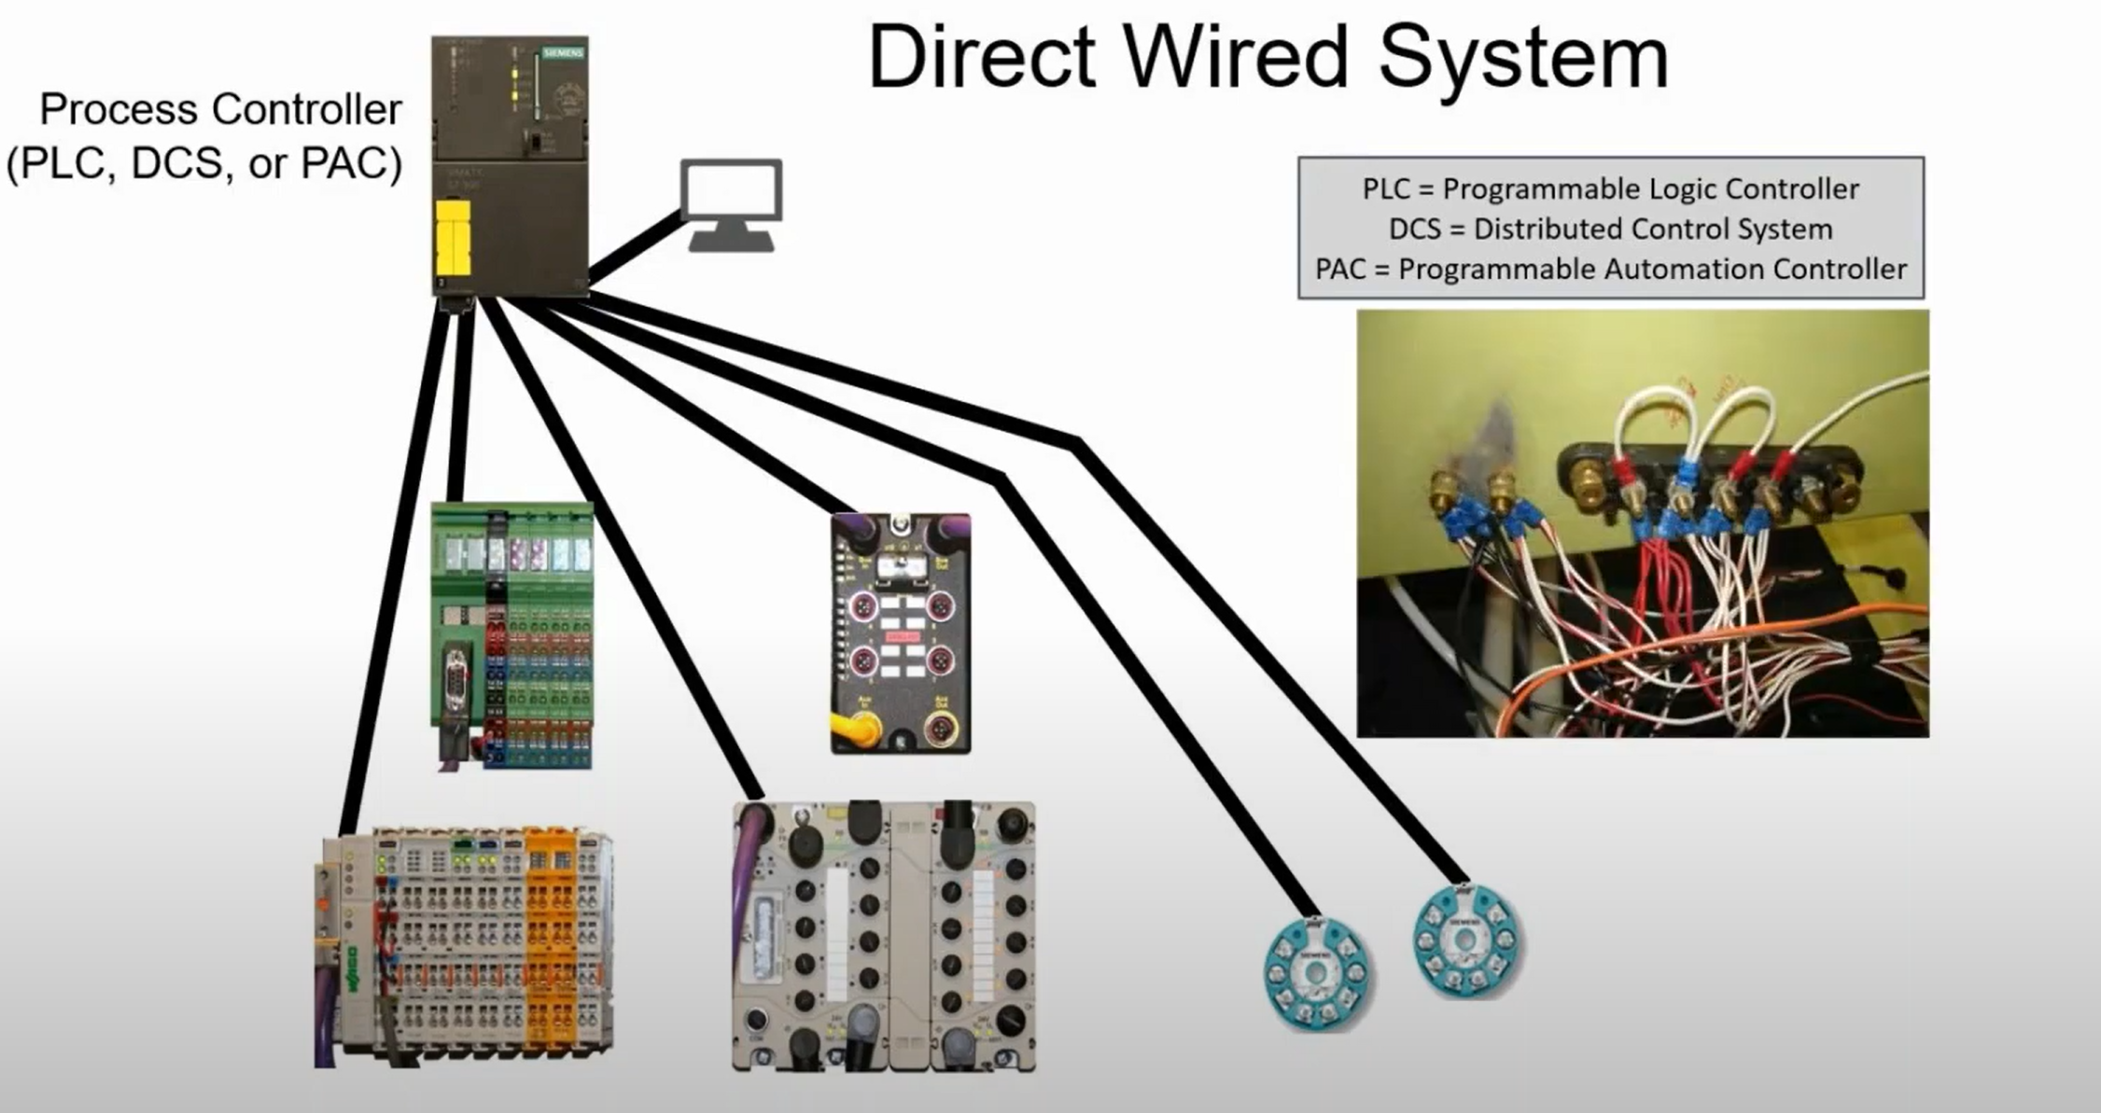
Befor PROFIBUS

Slide 3
Problems
Extensive cabling due to direct wiring
Diagnostics are limited
Signals can be susceptible to unwanted noise interference

Slide 4


PROFIBUS => Process fieldbus
Developed in 1989 by Siemens and PNO
Industrial communication protocol
Open standard
OSI Compliant
Used in Factory automation , Process automation , Drive technology , Hybrid application

Slide 5
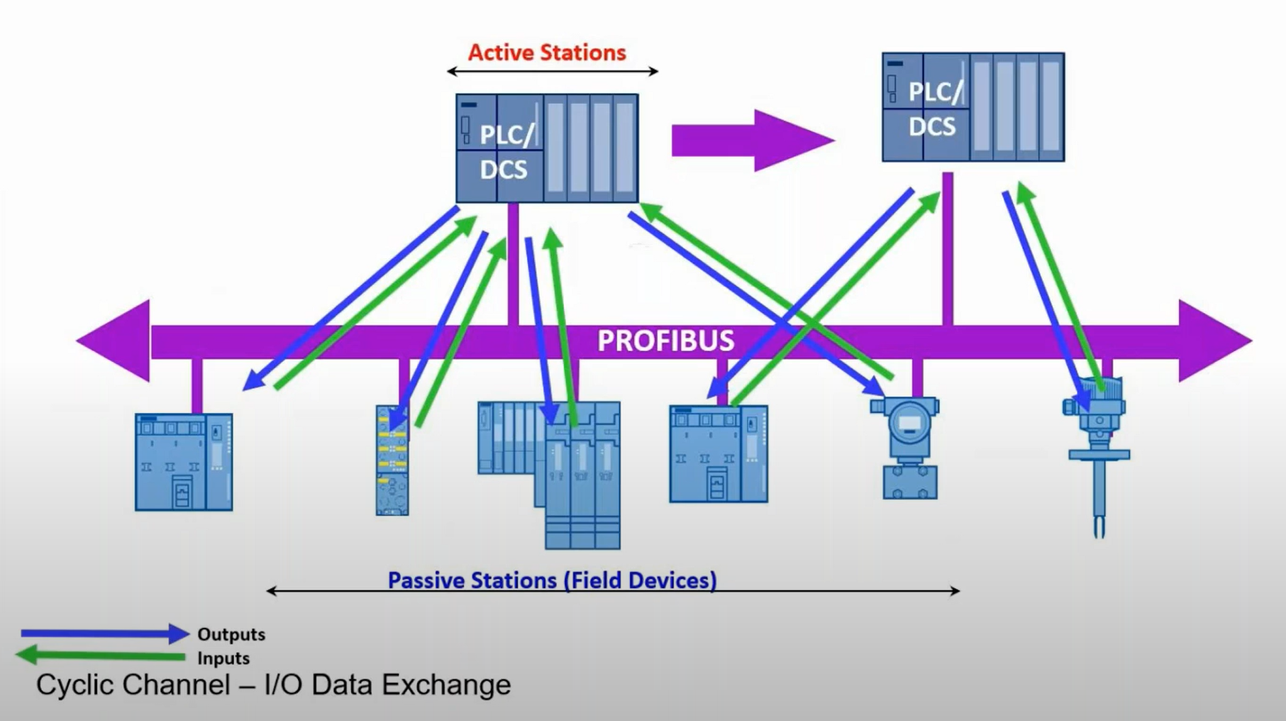
What is a fieldbus?
a field bus is a digital , serial , two-way , multi-drop communication link among controllers and its remote I/O, sensors ,acutators and inter-networking components

Slide 6
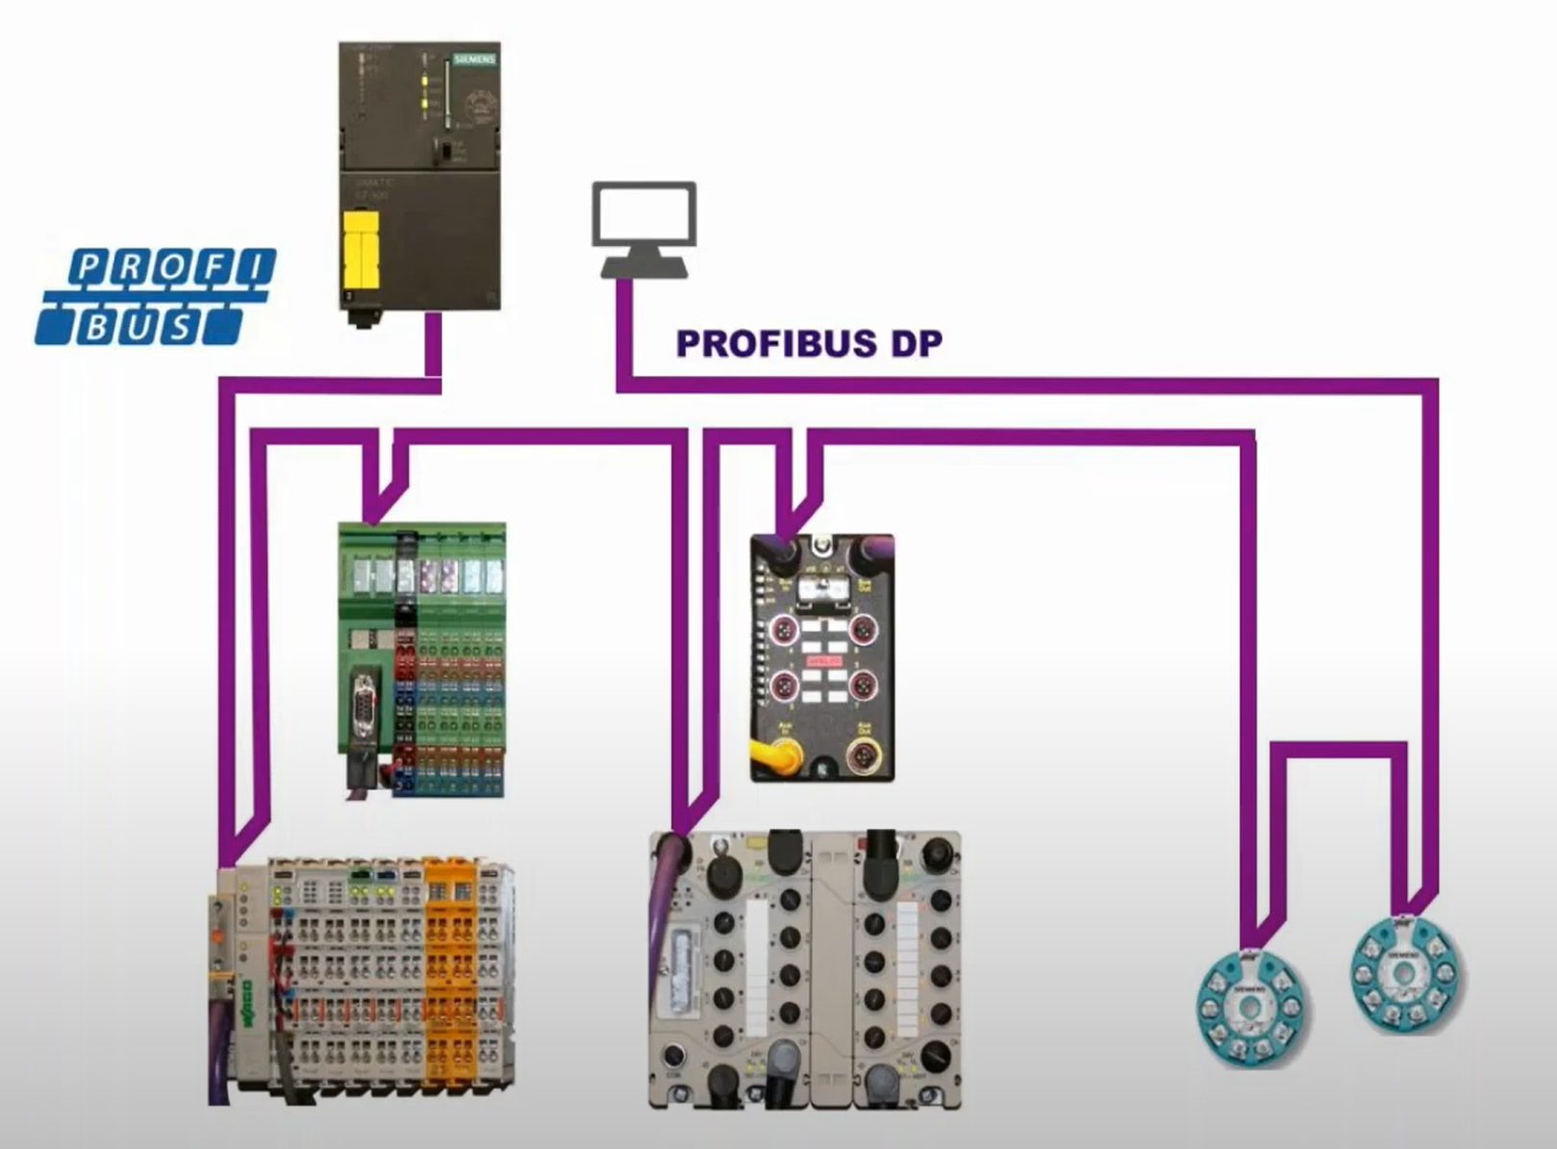
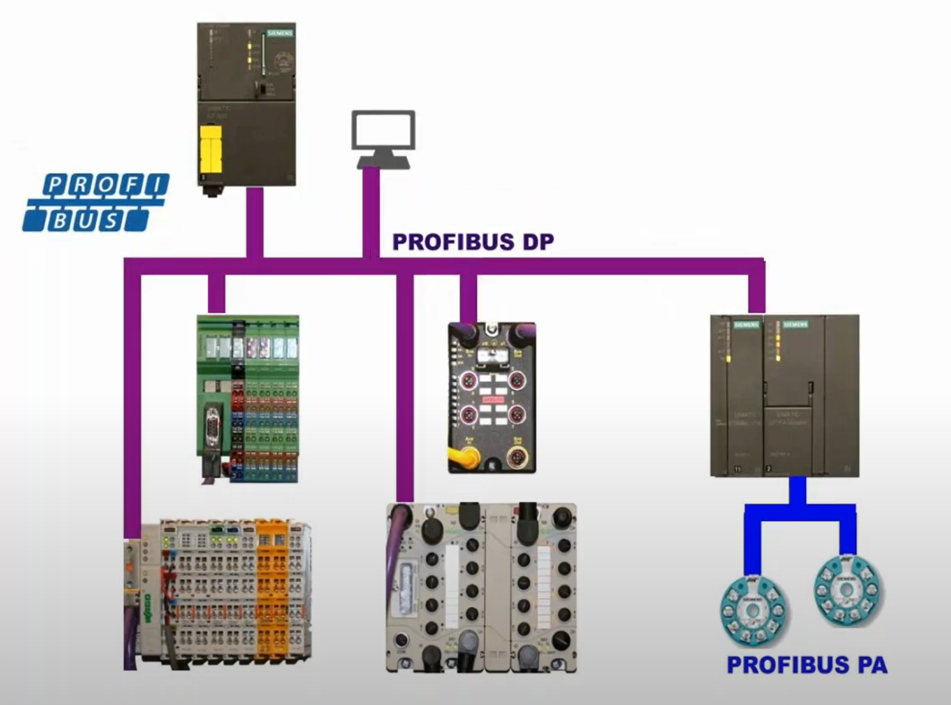
Types of PROFIBUS
1.PROFIBUS DP (Decentralized Peripherals) 2.PROFIBUS PA (Process Automation)

Slide 7
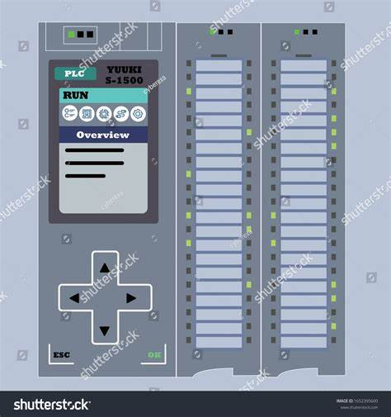
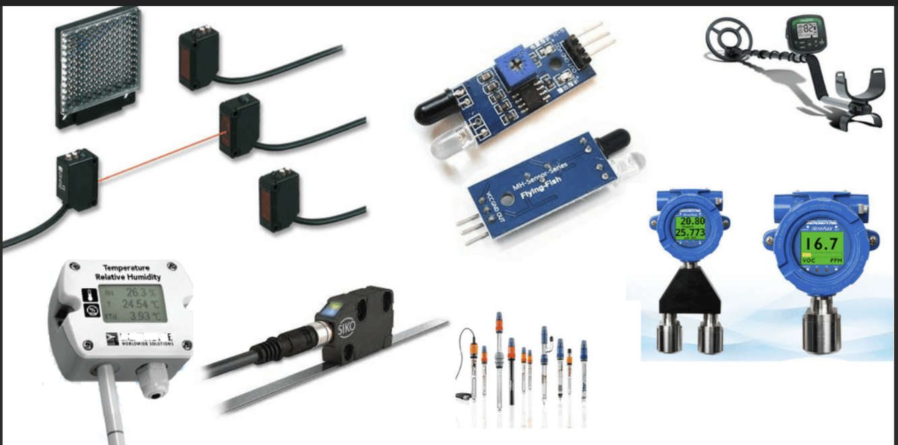
PROFIBUS DP
Two types of devices are supported
Master or active stations slave or passive stations
Control the bus receive messages
Send message without request Send message only on request

Slide 8
PROFIBUS DP
Multiple masters are allowed
Each slave assigned only to one master:
Multiple master can read from any device
Only one master can write to any device

Slide 9

PROFIBUS Communication
Two mechanism supported:
Token passing (master to master)
Polling
(master to slave)

Slide 10
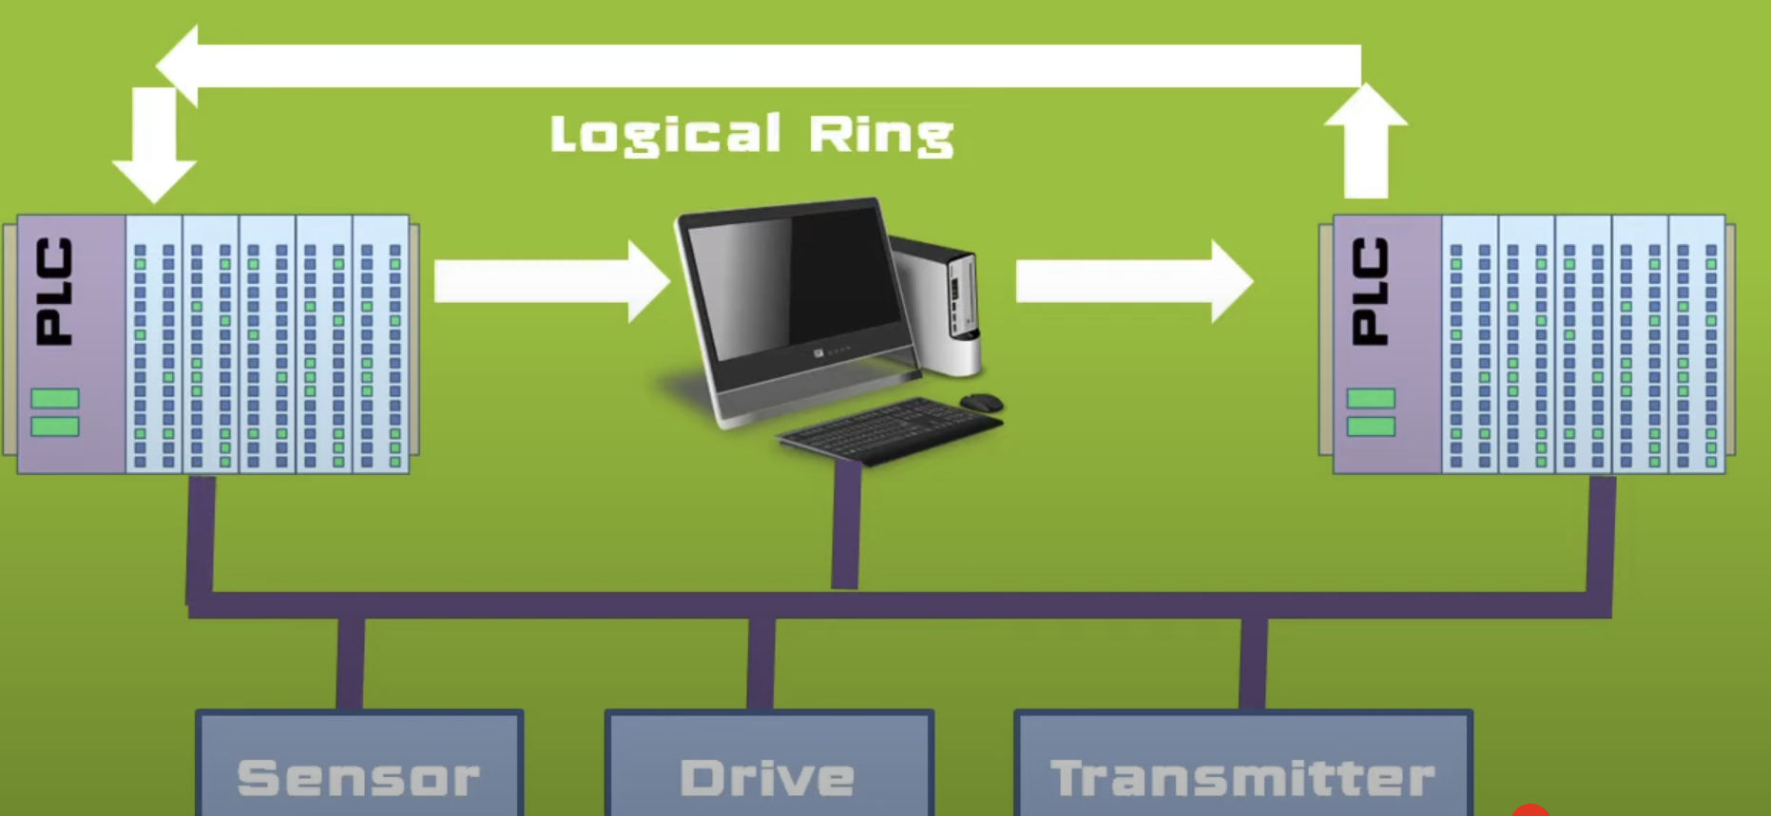
PROFIBUS Communication – token passing
During power up , lowest address master commences the initialization
and keeps the token with itself
When a master receives the token it can pass message to any slave or master
This software token is passed between the masters in ascending order, resulting in formation of a logical ring despite a bus topology.

Slide 11
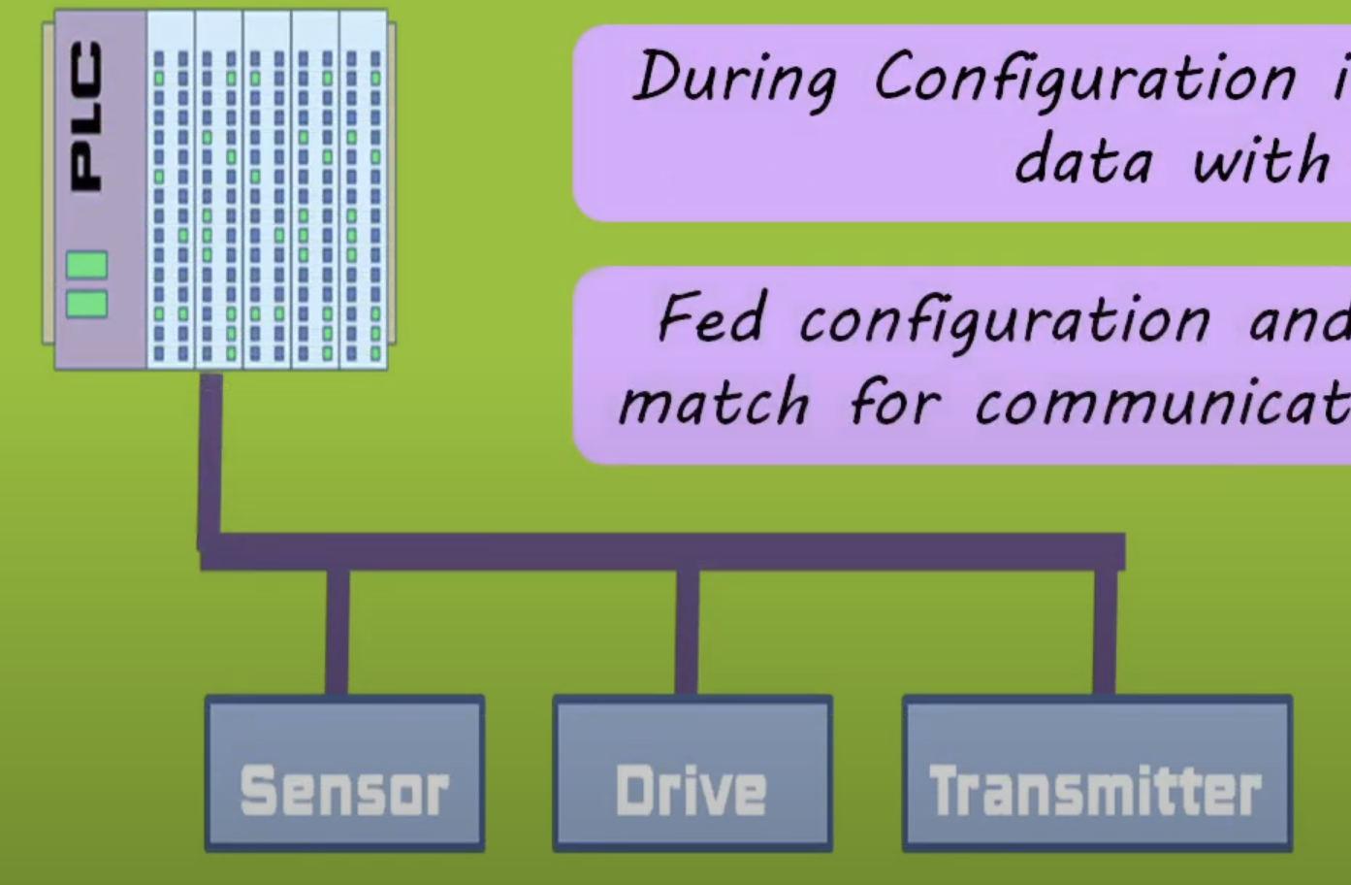
PROFIBUS Communication – polling
The Master initiates communication using Cyclic or Acyclic Messaging.
Slaves only respond when queried by the Master (they never initiate communication).

Slide 12
Polling-cyclic
Used for real-time control, where the Master continuously polls Slaves.
Process:
The Master sends a Cyclic Data Request.(request frame)
The Slave processes the request and replies with data.(response frame)
This process repeats at predefined intervals.
Example:
A PLC (Master) repeatedly polls a sensor (Slave) for temperature values every 10ms.

Slide 13
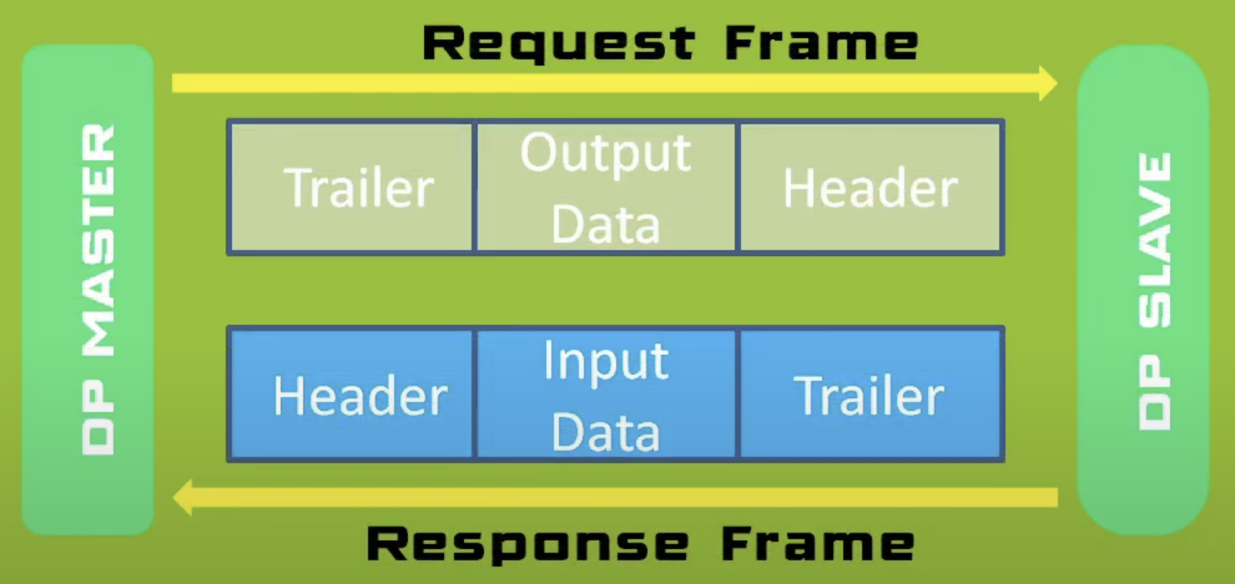
Polling-cyclic
Header and Trailer sections consists of information for addressing , error checking and other protocol related data.

Slide 14
Polling-Acyclic
Used for non-time-critical data like diagnostics, configuration, and maintenance.
Process:
The Master sends a special request (e.g., a configuration update).
The Slave processes the request and responds only once.
The normal cyclic process resumes.
Example:
A DCS (Master) requests firmware information from a field device.

Slide 15

Error Handling in PROFIBUS
Automatic Retransmissions: If a Slave fails to respond, the Master retries.
Timeouts: If multiple retries fail, the device is marked as faulty.
Checksum Validation: Ensures data integrity.

Slide 16
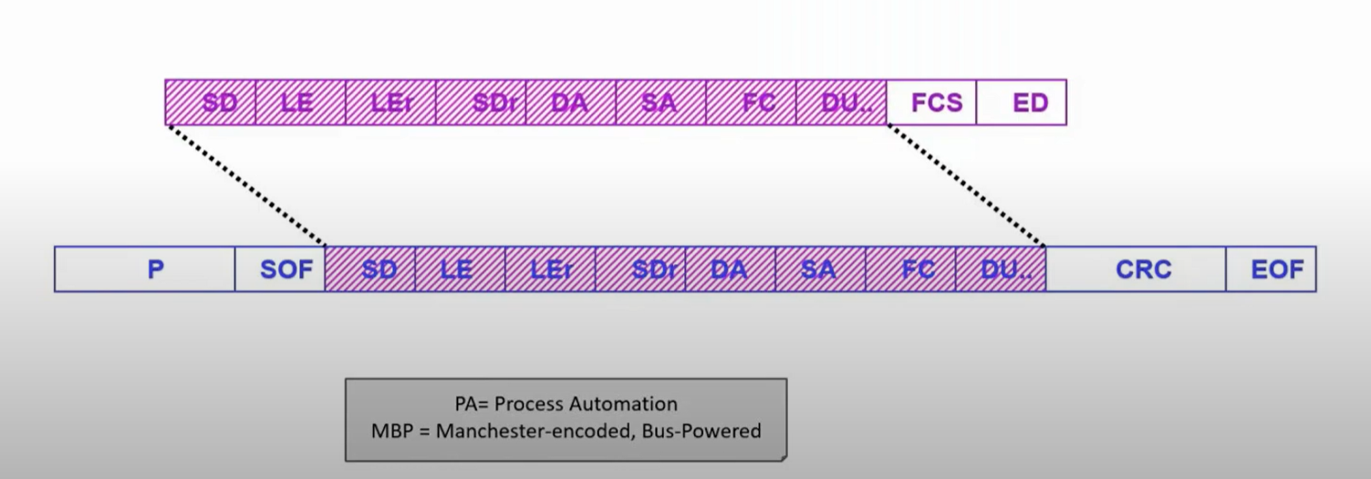
Profibus DP and PA
PROFIBUS is mainly used for high-speed input/output devices and to link intelligent devices such as drives.
It can use different physical layers such as RS-485 (most common), wireless, or fiber optics.
PROFIBUS PA refers to the following additional features:
Bus powered by using the Manchester encoded Bus Powered (MBP) physical layer according to IEC 61158-2.
Intrinsically safe design.
Configuration over the bus.
Device profile.

Slide 17
summary
Befor PROFIBUS
Fieldbus
Types of Profibus
PROFIBUS DP
PROFIBUS Communication
Error Handling in PROFIBUS
Comparing Profibus DP and PA

Slide 18
resources
What is PROFIBUS and how it works?
Online course on us.profinet.com
Siemens: PROFIBUS network manual

Slide 19
Thanks for your attention

